Slide 1
Rotary and Linear Motion Control System
Josiah Germain
ECE 4115 - Automatic Control Systems Laboratory
12/3/2025

Slide 2
Abstract
.
.
.
.
.
.
.
.
.
.
.
.
.
.
.
.

Slide 3
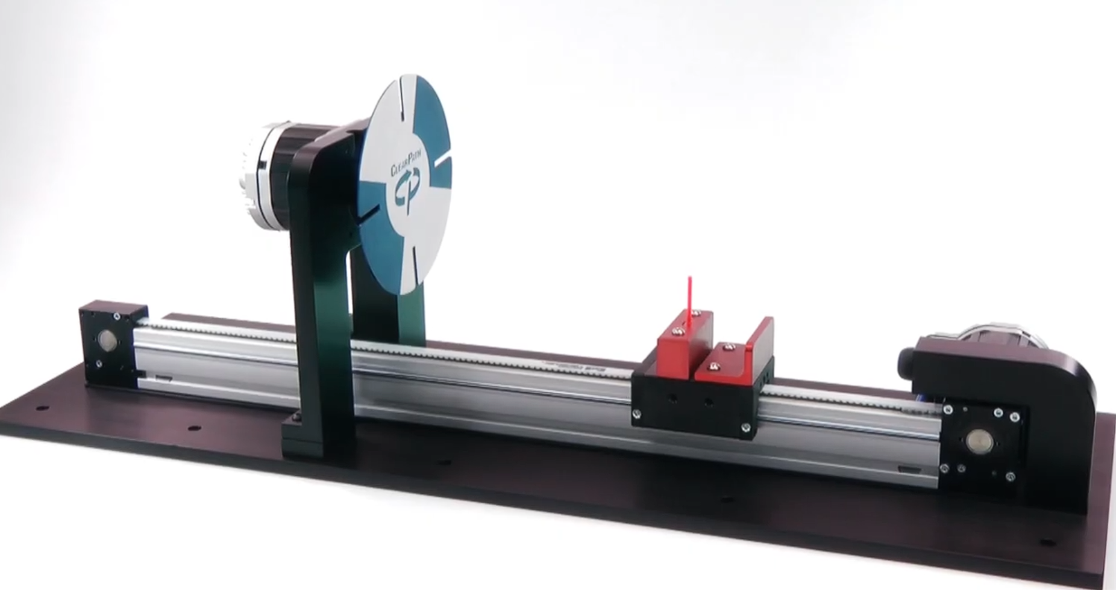
Introduction
The objective is to create an automatic control system for the purpose of guiding a slit through a rotating wheel. Simulations to confirm design are needed along with proper documentation.
Key principles:
Position and velocity control
Angular to linear motion conversion
Part selection
PID/PD feedback control and tuning
Developing transfer functions for motors
Simulations to verify design accuracy and timing

Slide 4
Objectives
Year/Quarter/Month
6
Document process and display results in slides.
5
Verify design with simulations and observations from produced graphs.
4
Design control system with PID for timing control and ensuring the cart stops after passing the wheel.
3
Convert angular motion to linear motion to determine the cart’s velocity from the wheel’s velocity.
2
Model servo motors mathematically accounting for mechanical and electrical properties.
1
Select components to meet system requirements.

Slide 5
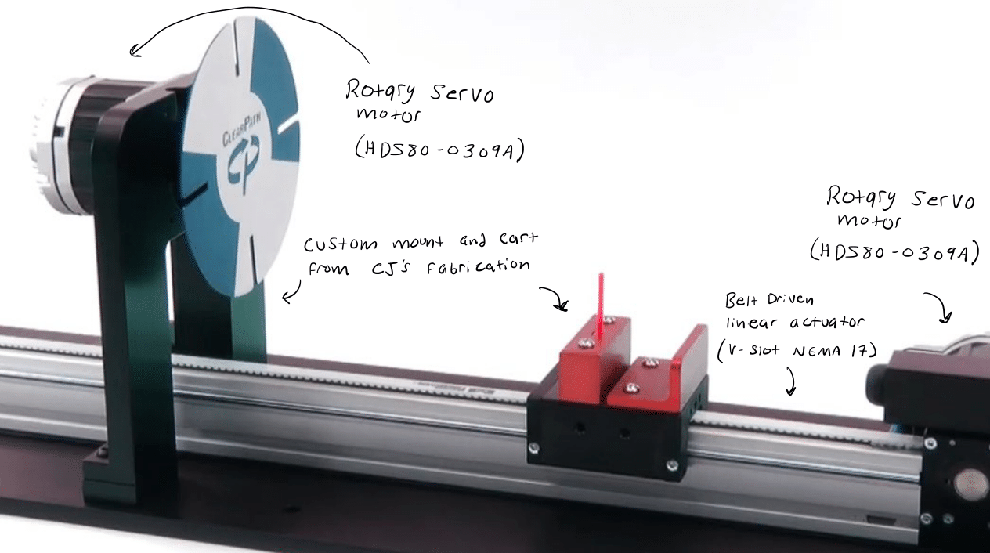
Company Name
Materials and
Components
Hardware:
Software:
2x Rotary servo motor (HDS80-0309A from ABB)
Belt driven linear actuator (V-Slot NEMA 17 from OpenBuilds)
Mount for wheel can be produced by CJ’s Fabrication
Matlab/Simulink

Slide 6
Project roadmap
Step 6
Simulate, evaluate accuracy and refine the design.
Step 5
Tune the PID/PD to ensure accurate timing and stopping distance.
Step 4
Design the control system in simulink with PID/PD feedback control.
Step 3
Develop a timing solution and method to stop cart.
Step 2
Derive the transfer function for the motor.
Step 1
Extract mechanical and electrical parameters from motor.

Slide 7
How the device works
Spinning Wheel:
Moving Cart:
A voltage is applied to the wheels motor to produce a constant velocity.
The angular velocity is integrated over time and multiplied by 57.30 to convert the result to degrees, improving the readability of the plotted data.
The cart’s angular velocity is first scaled by a factor of 10.61 to align its timing with the wheel. This value is then integrated and multiplied by the drive motor’s radius to convert it into linear distance
The resulting linear distance is returned to a summation junction and subtracted from the reference distance. This error signal serves as the PID input to achieve a controlled and smooth stopping point.

Slide 8
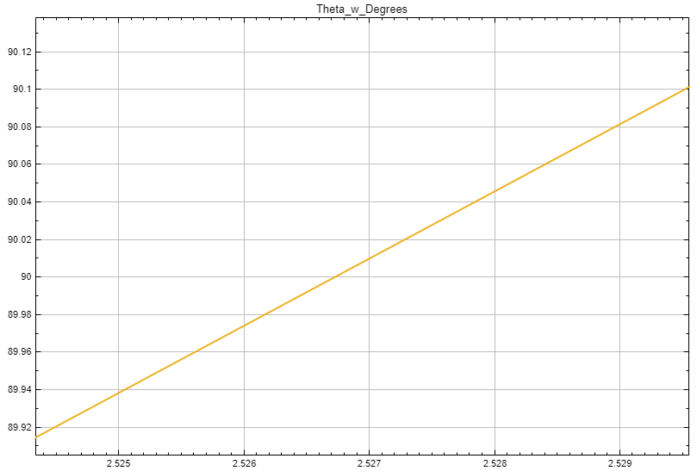
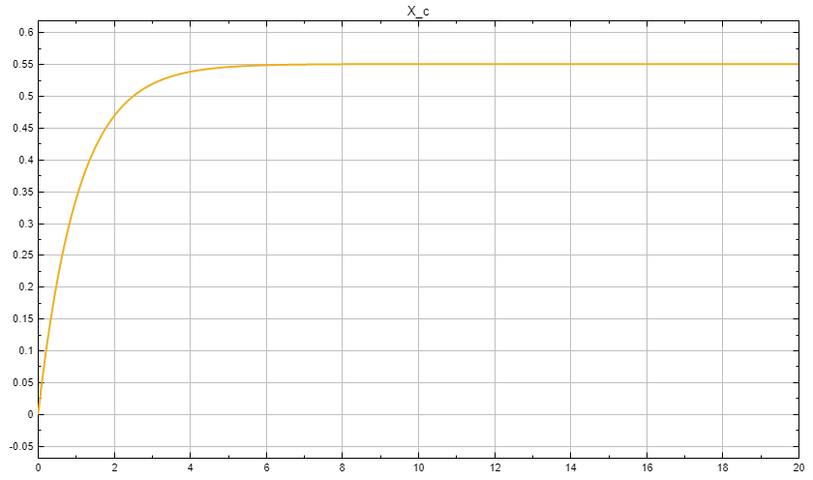
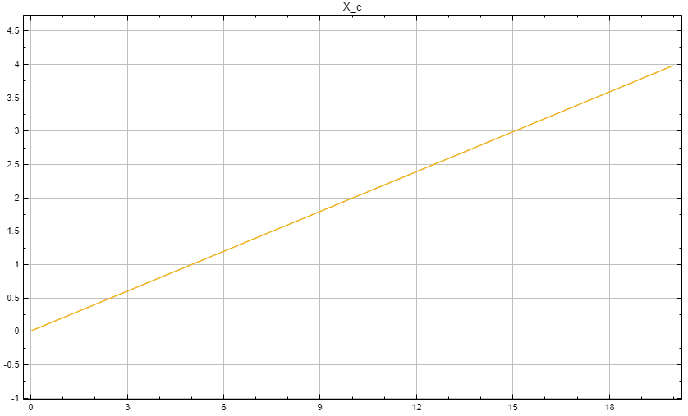
Data and Observation
Wheel’s angular velocity in degrees
Cart’s distance over time with PID control
Cart’s distance over time with no PID control
Observations:
The wheel’s angular velocity remains constant throughout the motion once the setpoint is applied. With PID control implemented, the cart’s position converges smoothly to the 0.55 [m] reference. Without PID control, however, the cart overshoots the target and continues driving forward, ultimately colliding with the end of the linear actuator.

Slide 9
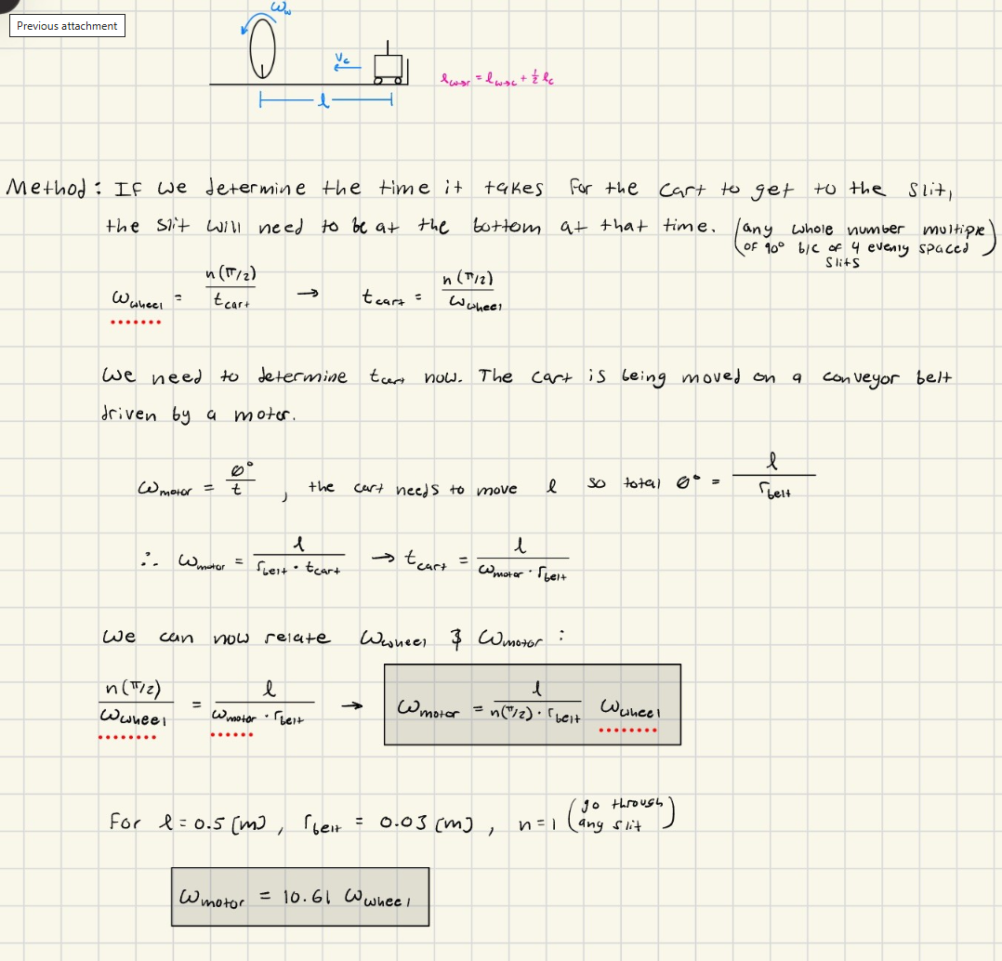
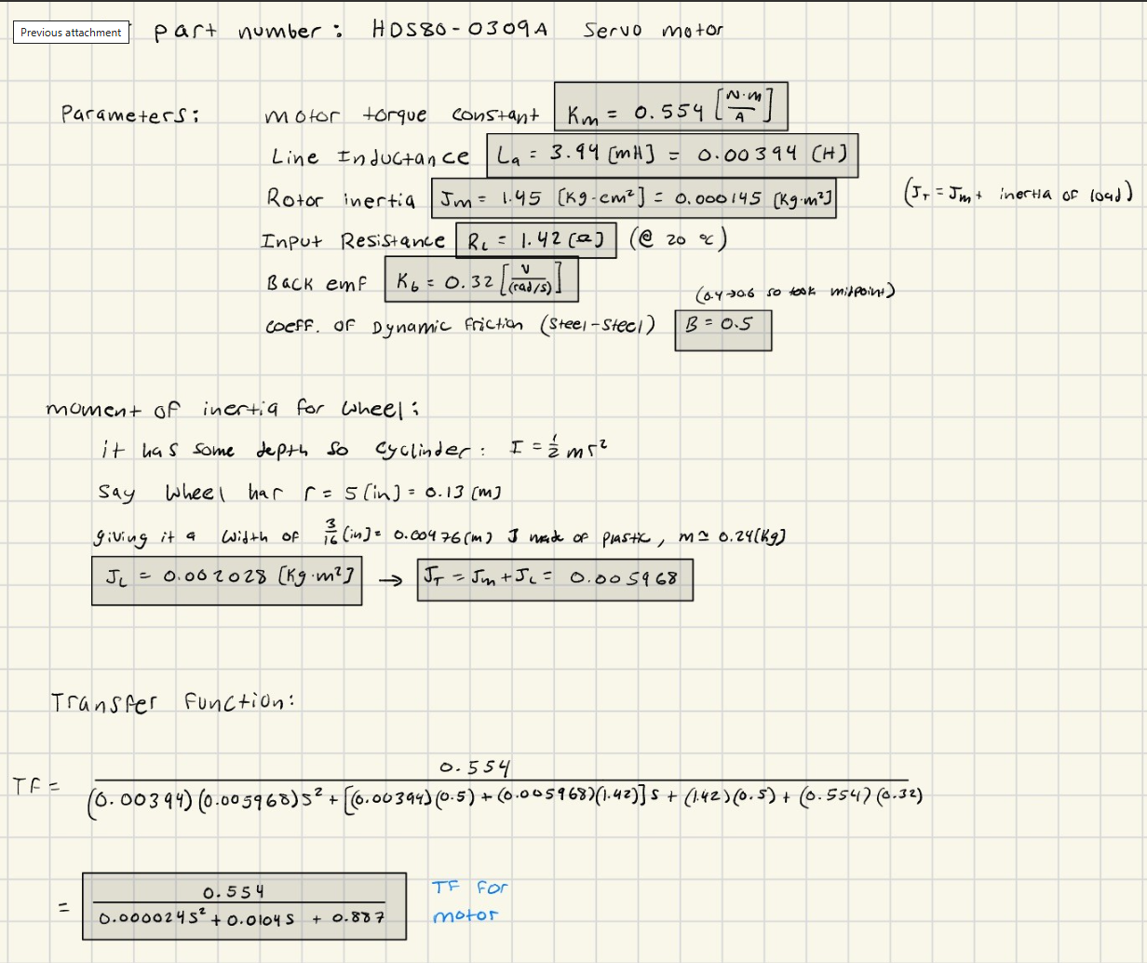
Results (Calculations)

Slide 10
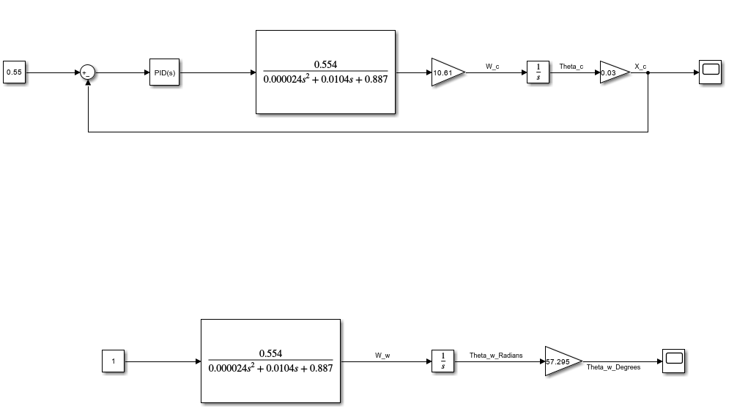
Results (Simulation)
The schematic above was used to obtain all simulated data

Slide 11
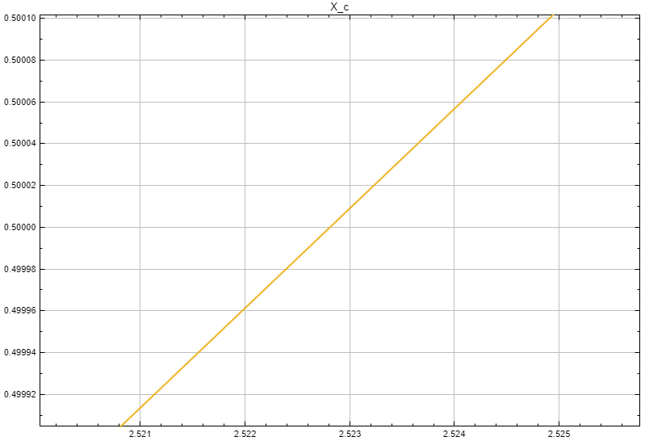
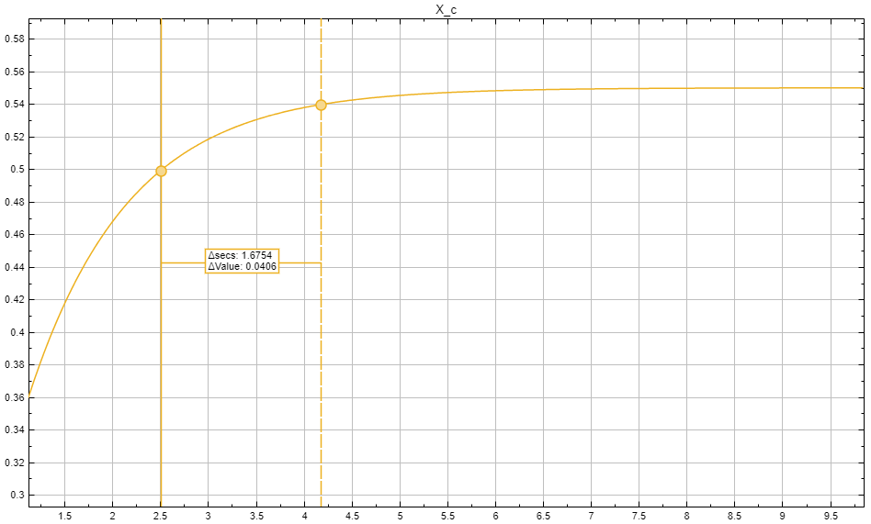
Results (Data)
Close up image for angular velocity of wheel
Close up image for linear distance of cart
Time it takes for the cart to come to resting position
How to obtain: The timing information is determined by plotting the cart’s linear position and the wheel’s angular position over time, then identifying when the respective events occur. The time required for the cart to come to rest after reaching the slit is measured using Simulink cursor tools.

Slide 12
Timing Analysis
To evaluate whether the system functions as intended, the cart’s arrival time at 0.5 [m] is compared with the wheel’s angular position at that same instant. Proper alignment occurs when the wheel’s angle is an integer multiple of 90°. Simulation results show that the cart reaches 0.5 [m] at t = 2.52 [s], while the wheel reaches 90° at t = 2.53 [s]. This mismatch of only 10 [ms], an error of 0.16%, demonstrates that the system’s timing accuracy is excellent.

Slide 13

End Position Analysis
An important performance metric for this system is the time required for the cart to come to a complete stop at its final position. This becomes critical if the design includes a return motion, where the cart must travel back through the wheel. If the stopping phase is too long, the return command may occur prematurely, causing timing misalignment. In our system, the cart’s stopping time is 1.68 [s], representing approximately 40% of the total run time from the start to end position, indicating a relatively slow deceleration phase.

Slide 14
Discussion
The primary sources of experimental error in the cart–wheel system include belt elasticity and backlash, linear-guide friction, motor and drive nonlinearities, sensor limitations, and mechanical misalignment. Belt stretch and play introduce deviations from the ideal kinematic relation 𝑥 = 𝑟𝜃, causing the cart to reach the slit earlier or later than predicted. Friction alters acceleration and deceleration profiles, increasing rise time and stopping distance relative to the ideal second order response. Motor and driver nonlinearities, such as current limits, deadtime, and torque ripple, further affect overshoot and settling behavior. Sensor quantization and latency introduce uncertainty in detecting the 0.5 [m] position and the slit-alignment time; these effects can be evaluated through repeated trials and statistical analysis of arrival-time and position dispersion. Mechanical misalignment of the wheel, cart, and slit introduces a systematic offset between the theoretical and actual clearance window. In practice, the theoretical model yields a single deterministic timing value, whereas experimental results exhibit a biased mean with finite variance; comparing this variance to the allowable geometric window provides a rigorous assessment of system performance.

Slide 15
Conclusion
(Key Outcomes)
The experiment shows that the cart can be driven so it passes the slit at the correct time and then stops slightly beyond it, confirming that the derived kinematic ratio and control strategy are physically achievable. The timing between the cart reaching 0.5 m and the wheel’s slit alignment is close to the theoretical value, and the position loop can be tuned to give small, acceptable overshoot while still protecting the pin

Slide 16
Conclusion (Original Question)
The original question was whether a motor driven cart could be synchronized with a rotating four slit wheel so a pin reliably passes through a slit instead of colliding with the disc. The successful timing and repeatable passage through the slit show that the analytical relationship between wheel speed, cart travel, and distance L is valid in practice within experimental uncertainty, while the tuning effort and small deviations highlight the influence of friction, compliance, and sensing limits.

Slide 17
Conclusion (Improvements)
Future work could improve robustness by adding wheel speed or wheel angle feedback so the cart automatically tracks changes in wheel speed, or by using a two stage or trajectory based controller (fast approach, then shaped deceleration) to shorten the tail without losing timing accuracy. Mechanical and sensing upgrades, stiffer belts, better alignment and higher resolution encoders could reduce timing and position uncertainty, and more advanced studies could compare different control strategies or slit configurations to find the best balance between timing precision, stopping accuracy, and implementation complexity.

Slide 18
References
[1] Teknic Inc, “ClearPath: Teknic's Integrated Brushless Servo Motor, Drive and Encoder, YouTube, May 10, 2018. [Online]. Available: https://www.youtube.com/watch?v=_SYhCRwacDs
[2] ABB (Baldor-Reliance), HDS High-Performance AC PM Servo Motor Data Sheet, version 02/21, 44-page PDF. [Online]. Available: https://www.baldor.com/mvc/DownloadCenter/Files/9AKK107304
[3] Wolfram Research, Inc., “Moment of Inertia of a Cylinder,” Wolfram Formula Repository. [Online]. Available: https://resources.wolframcloud.com/FormulaRepository/resources/Moment-of-Inertia-of-a-Cylinder
[4] SDP/SI, “Timing Belt Pulleys,” SDP/SI Products. [Online]. Available: https://sdp-si.com/products/Timing-Belt-Pulleys/index.php
[5] OpenBuilds, “V-Slot NEMA 17 Linear Actuator Bundle (Belt-Driven),” OpenBuilds. [Online]. Available: https://us.openbuilds.com/v-slot-nema-17-linear-actuator-bundle-belt-driven/
[6] CJ’s Machine & Fab, “Custom Brackets and Mounts,” CJ’s Machine & Fab. [Online]. Available: https://www.cjsmachineandfab.com/custom-brackets

